Slide 1
The Role of The Board
Mr Amjad Nazir - Head of Health, Safety, Environment and Security
South East Coast Ambulance Service NHS Foundation Trust

Slide 2
Agenda
Introduction from Amjad Nazir
The Role of the Board
CQC & Health, Safety & Fire
Estates
Health & Safety Audits
Business Cases
Questions & Answers

Slide 3
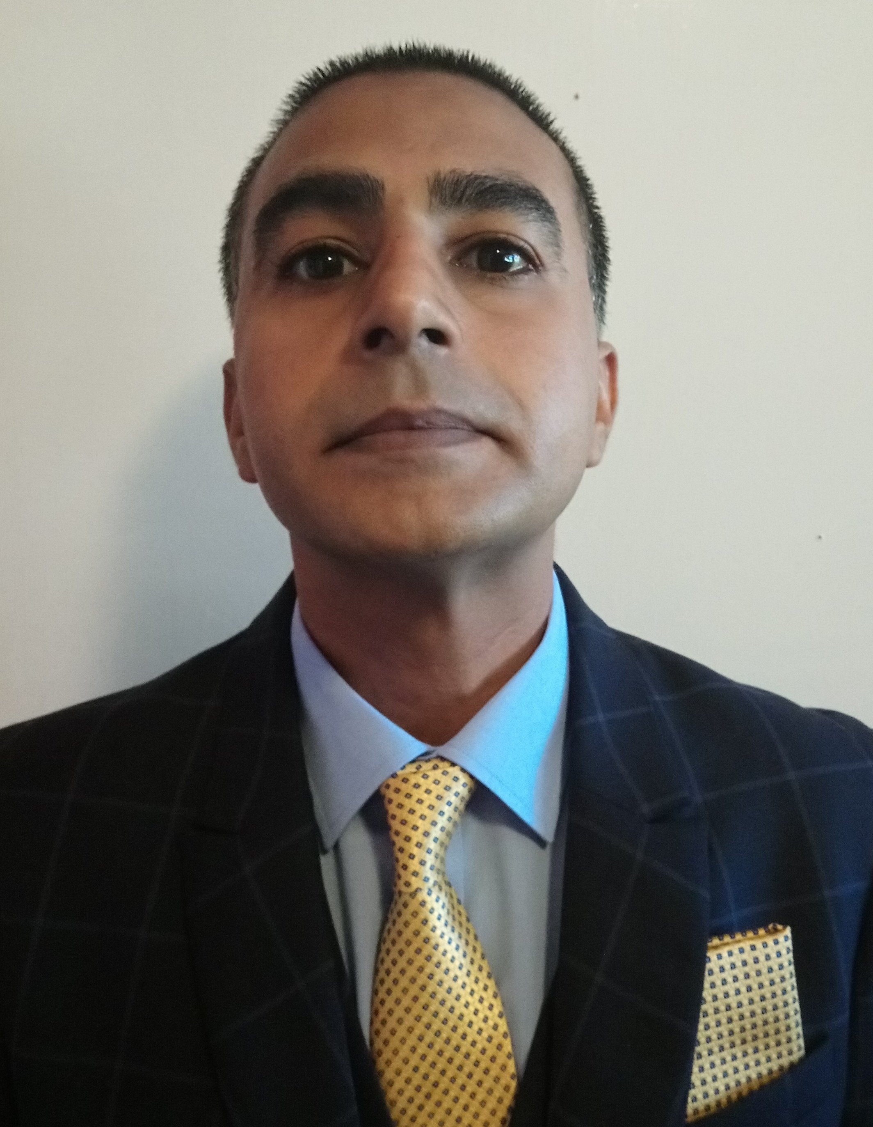
Introduction from Amjad Nazir
Most of my H&S career has involved working in organisations that have received HSE Improvement notices. I have been recruited into roles to provide significant compliance improvements and satisfy the HSE requirements.
I have worked on collaborative projects with the HSE
Health & Safety Examiner and Independent advisor for RSPH
12 months ago, I was selected by the NHS Leadership Academy to undertake a board development course. Completion of the course can lead to board roles across the NHS.
SECAmb Lead for Board Assurance Safety & Engagement
NHS Top Talent Board Assessor (south east region)
Interviewed x2 CEO
Interviewed x6 NED’s for various roles
Specialist interest in Occupational related diseases (Respiratory and Dermatology)
Engineer by background
I have been a Registered CQC Manager for an Outstanding rated organisation

Slide 4
Introduction from Amjad Nazir

Slide 5
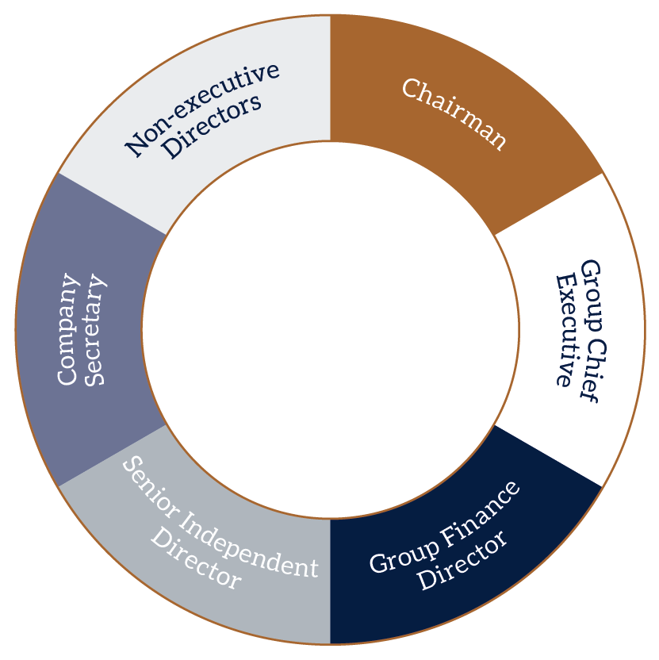
Board Structure

Slide 6
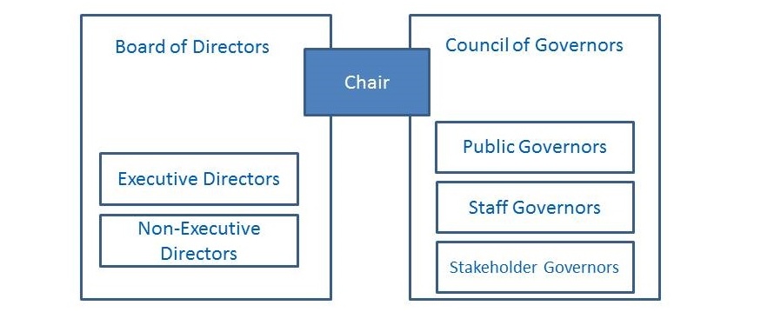
NHS Foundation Trust

Slide 7
What are NHS Foundation Trusts?

Slide 8
NHS Foundation Trusts are established as independent, not for profit with accountability to their local communities rather than central government.
Foundation Trusts have a greater connection to their local communities and staff over the delivery and development of local healthcare.
They have financial freedom and can raise capital from both the public and private sectors within borrowing limits.
Each NHS Foundation Trust has a duty to consult and involve a Board of Governors (comprising patients, staff, members of the public and partner organisations) in the strategic planning of the organisation.

Slide 9
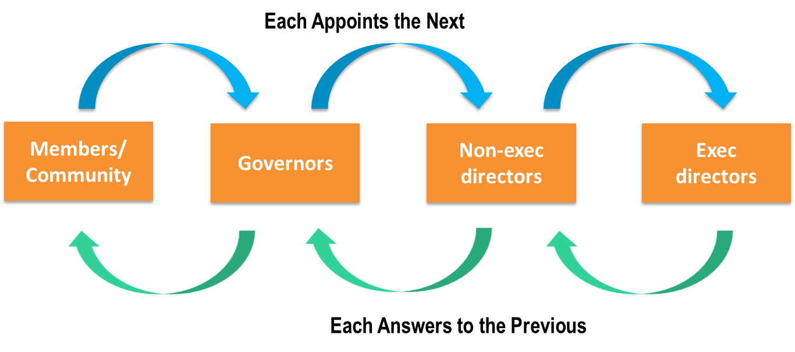
Appointing Structure Foundation Trust

Slide 10
Role of the Trust Chairman
The Trust Chairman is responsible for leading and presiding over the Board of Directors and for ensuring that they successfully discharge their responsibilities.
The Trust Chairman is the guardian of the Board of Directors’ decision-making processes and provides general leadership of the Board of Directors.
The Trust Chairman is responsible for the effective running of the Board of Directors and ensuring each Non-Executive Director is subject to annual performance appraisal and supervision on a more frequent basis.

Slide 11
Role of the Chief Executive
The Chief Executive reports to the Trust Chairman.
The Chief Executive is responsible for implementing the decisions of the Board of Directors and its Committees and providing information and support to the Board of Directors.
The Chief Executive is responsible to the Board of Directors for running the Trust’s business and for proposing and developing the Trust’s strategy and overall objectives for consideration and approval by the Board of Directors.

Slide 12
There is no difference between responsibilities and accountability of executive and non-executive directors.

Slide 13
The general responsibilities of the Board of Directors are:
To ensure compliance with all applicable law, regulation, and statutory guidance;
To maintain and improve quality of care;
To work in partnership with patients, local health organisations, local government authorities and others to provide safe, effective, accessible, and well governed services for patients;
To ensure that the Trust meets its obligations to the population served, its stakeholders and its staff in a way that is wholly consistent with public sector values;

Slide 14
The Board (Leadership)
The Board of Directors:
Provides active leadership to the organisation
Ensuring there is a clear vision and strategy for the Trust that staff know about and that is being implemented, within a framework of effective controls which enable risk to be assessed and managed.
Implementing effective Committee structures and clear lines of reporting and accountability throughout the organisation.

Slide 15
The Board Committee
Example

Slide 16
The Board (Quality)
The Board of Directors:
Ensures that the Trust provides a high quality of service and outcomes for its patients;
Requires that the best levels of clinical effectiveness, patient safety and patient experience, are achieved;
Ensures that it engages with all its stakeholders, including patients and staff on quality issues and that issues are escalated appropriately and dealt with.

Slide 17
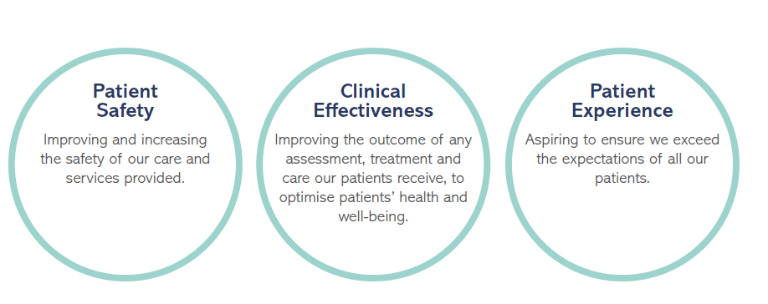
Elements of Healthcare quality

Slide 19
Culture, Ethics and Integrity
The Board of Directors:
Responsible for setting values, ensuring they are widely communicated and adhered to and the behaviour of the Board is entirely consistent with those values.
Promote a patient-centred culture of openness, transparency and candour;
Ensures that high standards of corporate governance are maintained in the conduct of NHS Foundation Trust business.

Slide 20
Behaviour and Leading by example

Slide 21
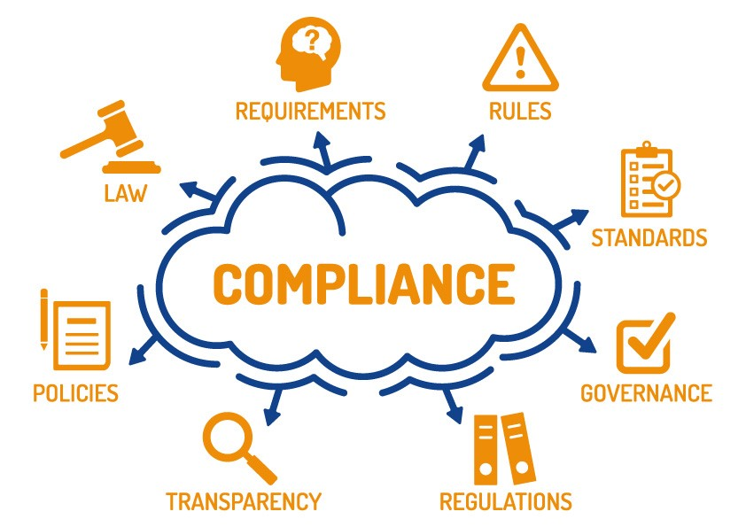

Slide 22
Board Governance & Compliance
The Board of Directors:
Ensures compliance with relevant principles, systems and standards of good corporate governance;
Ensures that the statutory duties of the trust are effectively discharged;
Ensures that all the required returns and disclosures are made to the regulators;
Acts as corporate trustee for the Trust’s charitable funds.

Slide 23
Board (Risk Management)
The Board of Directors:
Ensures an effective system of integrated governance, risk management and internal control across the whole of the Trust’s clinical and corporate activities;
Ensures that there are sound processes and mechanisms in place to ensure effective patient care.

Slide 24
Board Communication
The Board of Directors:
Ensures an effective communication channel exists between the Trust, members, patients, staff and the local community.
Holds its meetings in public except where the public is excluded 'for special reasons’
Shares the agenda and minutes of Board of Directors meetings;
Publishes an annual report and annual accounts electronically via the Trust’s website and in accessible versions;
Holds an annual general meeting which is open to the public.

Slide 26
Board (Finance)
The Board of Directors:
Ensures that the Trust operates effectively, efficiently and economically;
Ensures the continuing financial viability of the organisation;
Ensures the proper management of resources and that financial responsibilities are fulfilled;
Ensures that the Trust achieves the targets and requirements of stakeholders within the available resources.

Slide 28
Health, Safety & Fire (CQC)
Related guidance | Applies to (reg no)
For all services
Health and Safety Executive guidance | HSCA 12, 15, 18
Sharp Instruments in Healthcare Regulations 2013 (Health and Safety Executive) | HSCA 12, 15, 18
Selection latex gloves (Health and Safety Executive) | HSCA 12, 15, 18
Natural rubber latex sensitisation in health and social care (Health and Safety Executive) | HSCA 12, 15, 18
Managing for health and safety (Health and Safety Executive) | HSCA 12, 15, 18
Managing for health and safety - HSG65 guidance (Health and Safety Executive) | HSCA 12, 15, 18
Leadership (Health and Safety Executive) | HSCA 12, 15, 18
Leading health and safety at work (Health and Safety Executive) | HSCA 12, 15, 18
Guidance for health and social care services (Health and Safety Executive) | HSCA 12, 15, 17, 18
Consulting employees on health and safety: A brief guide to the law (Health and Safety Executive) | HSCA 18
Violence at work: guidance for employers (Health and Safety Executive) | HSCA 18
Health and safety in care homes (Health and Safety Executive, June 2014) | HSCA 12, 15, 17, 18
Sharps injuries (Health and Safety Executive) | HSCA 12, 15, 18
NHS Employers: Workplace health and safety standards | HSCA 12, 15, 17, 18
Ventilation (Health and Safety Executive) | HSCA 15
Related guidance | Applies to (reg no)
For all services
Regulatory Reform (Fire Safety) Order 2005 (London Fire Brigade) | HSCA 15
Regulatory Reform (Fire Safety) Order 2005: a short guide to making your premises safe from fire (HM Government) | HSCA 15
For adult social care services
Fire safety risk assessment: Residential care premises | HSCA 15
Regulation 12: Safe care and treatment
Regulation 15: Premises and equipment
Regulation 17: Good governance
Regulation 18: Staffing

Slide 29
CQC Offence Chart
Reg no | Regulation | Action we take
12 | Safe care and treatment | Prosecution with qualifications*
15 | Premises and equipment | Regulatory action other than prosecution
17(1) | Good governance 1. Systems or processes must be established and operated effectively to ensure compliance with the requirements in this Part. | Regulatory action other than prosecution
18 | Staffing | Regulatory action other than prosecution

Slide 30
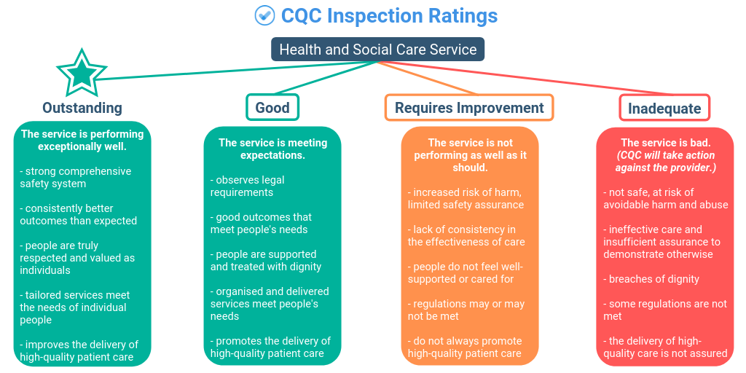
Example

Slide 31
Working with Estates
Work in collaboration with your Estates teams;
Ensure any new builds and refurbishments include H&S requirements within the Estates business case;
Estates should be members of the H&S committee
Set up sub-groups if needed for Fire, security and Legionella

Slide 32
Health & Safety Committee and sub-group example
Health & Safety Committee Frequency of Meetings Quarterly
East Region
Health & Safety
Sub-Group
Frequency of Meetings Quarterly
West Region
Health & Safety
Sub-Group
Frequency of Meetings Quarterly
Central Region
Health & Safety
Sub-Group
Frequency of Meetings Quarterly
Fire Safety Group
Frequency of Meetings Quarterly
(Chair) Amjad Nazir
Water Safety Group
Frequency of Meetings Quarterly
(Chair) Amjad Nazir
Violence & Aggression Reduction Group
Frequency of Meetings Bi-Monthly
(Chair) Amjad Nazir

Slide 33
Health & Safety Audits (internal & external)
Internal
To conduct an internal audit you require at least one team member with the right training and qualifications. The main advantage of the in-house option is greater control over the process. It can take place in stages, for example, to minimise disruption.
External (report to Audit & Risk Committee)
Can be useful to pick up any resource issues within the H&S department!
An external health and safety audit is the gold standard, in line with the HSE Best Practice Document (HSG65) which specifies an “independent assessment of your safety management systems”.

Slide 34
Business Case
a) What options have been considered? Please provide a high-level summary narrative of the options:
Options | Brief description | Benefits | Downsides/risks
Do Nothing or Do Minimum
Option 1 (preferred option)
Option 2
Option 3
Strategic Case
a) What will happen if we do not support the proposal? Is it a must do i.e. due to a regulatory requirement? Please highlight if this relates to a risk on the Corporate Risk Register

Slide 35
?

